Slide 1
The standard for academic excellence, innovation, and research
800 World's Fair Park, Knoxville, TN 37902
Notes:
Introduce yourselves as student ambassadors known as Gryphon Guides
Include name, grade, and mention you attended the school we are presenting at if thats the case

Slide 2
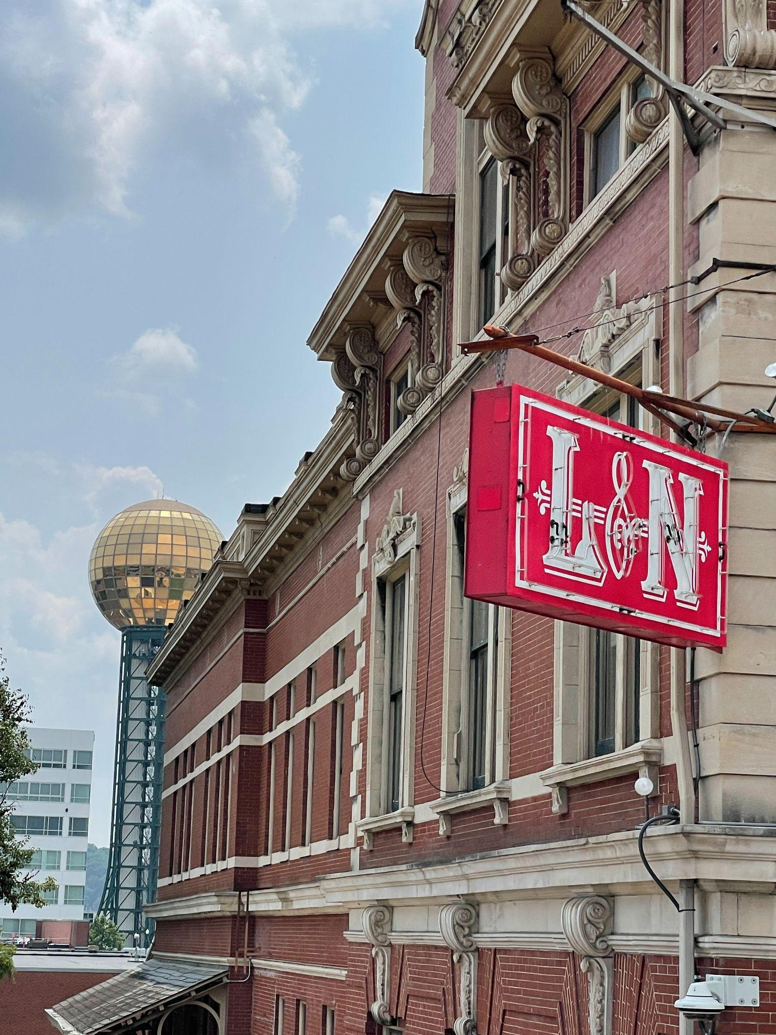
600 students
51% Male students and 49% female students
Diverse and high performing student body
Unique opportunities in science, computer science, & engineering
CULTURE OF LEARNING AND EXCELLENCE
CHALLENGING COURSES WITH FOCUS ON COLLEGE & CAREER PREPARATION IN STEM FIELDS
9:30 AM - 4:30 PM School day
#1 ranked high school in east tennessee
Largest offering of Advanced Placement & Dual Enrollment Courses in Knox County
Unique partnership with the university of tennessee for dual enrollment offerings, campus use, and research opportunities
Notes:
Making a connection between our school and its location is a great way to get things started. I like to ask the 8th graders are familiar with the sunsphere, and go from there.
Some other great things to mention when reviewing the first slide

Slide 3
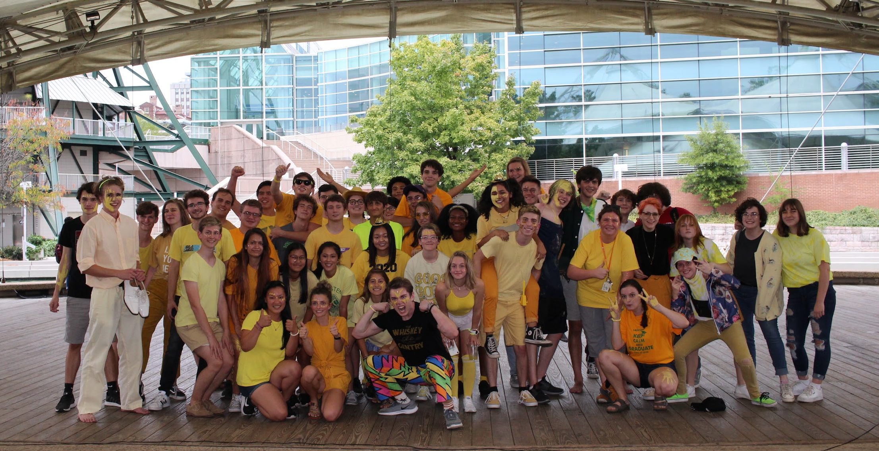
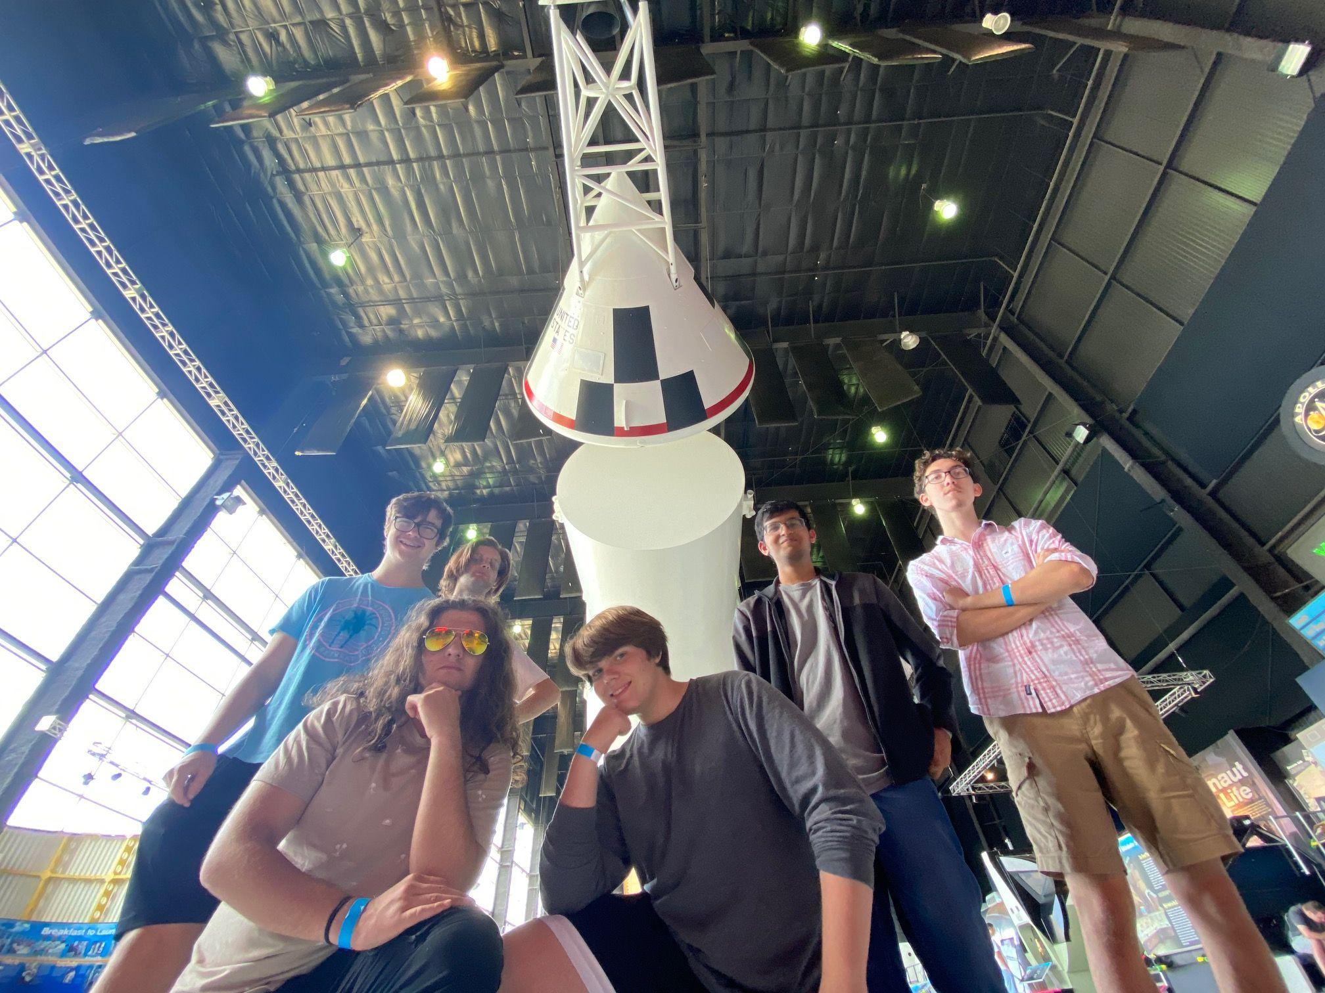
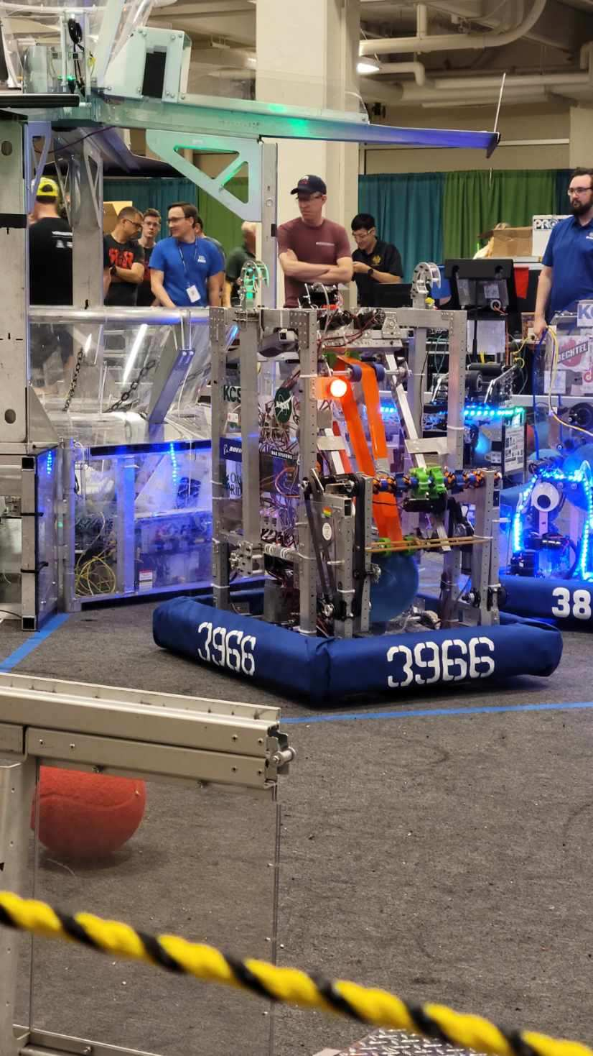
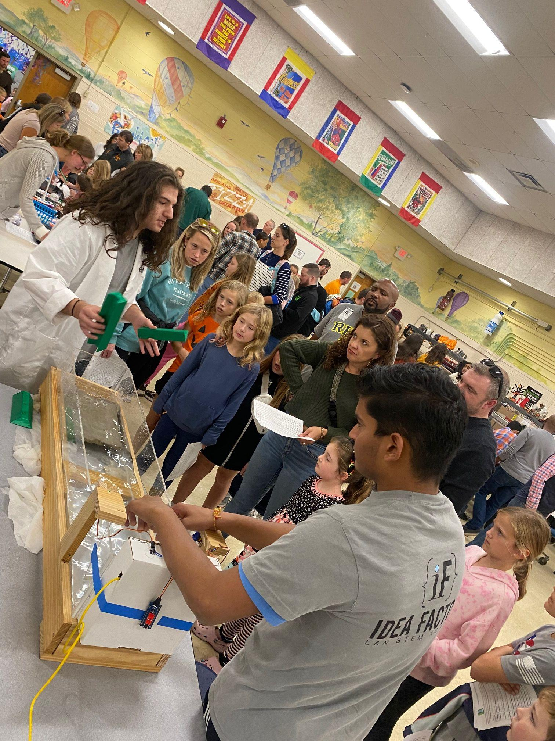
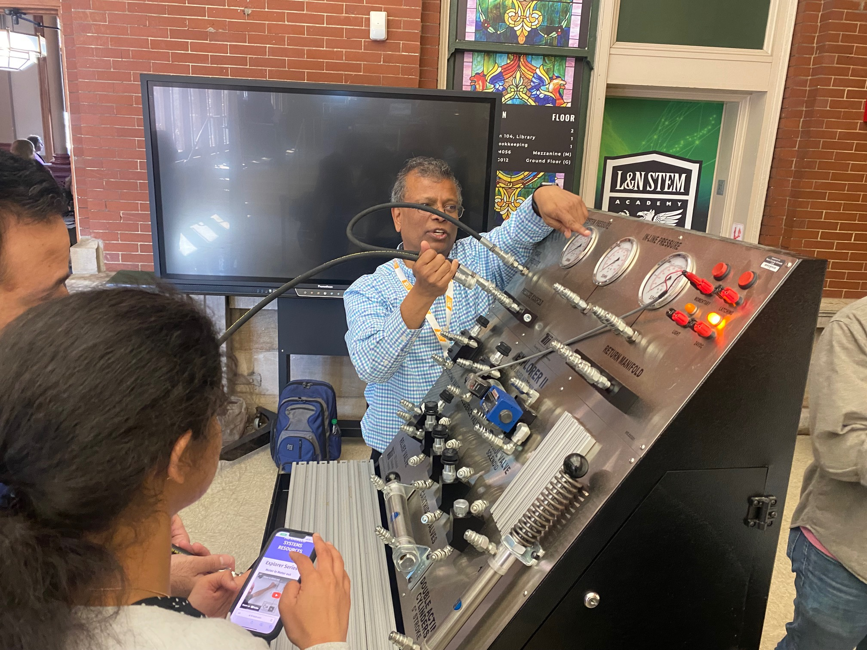
THOUGH OUR FOCUS IS ON PREPAREDNESS FOR COLLEGE THROUGH ACADEMIC EXCELLENCE, WE BELIEVE IN A FUN AND WELL-ROUNDED EDUCATIONAL EXPERIENCE!
TSSAA Sports including cross country, track, tennis, golf, bowling, as well as rowing, swimming & diving & Ultimate Frisbee
Dozens of clubs and organizations
Students have access to a brand new, $600,000 Maker space and engineering lab with state of the art equipment for all sorts of needs!
Notes:
Sports
Clubs/Genius Hour
Field Trips
Dances

Slide 4
STUDENTS CHOOSE ONE OF FOUR PATHWAYS AFTER THE 9TH GRADE:
-COMPUTATIONAL SCIENCE & CYBERSECURITY
-PHYSICS, MECHANICS, & ENGINEERING
-ADVANCED INQUIRY & RESEARCH
-DESIGN THINKING
STUDENTS ARE EXPOSED TO INTERNSHIPS, RESEARCH EXPERIENCES, COMMUNITY SERVICE, COLLEGE VISITS, AND MUCH MORE!
Notes:
Information about the school of Computational Science & Cybersecurity School: This school prepares students for the research rigor in the area of Computer Science, Mathematics, Coding, and Cybersecurity, and other academic majors in colleges. This is an ideal track for students interested in Computer Science, Coding, Cybersecurity, and Mathematics.
Information about the school of Physics, Mechanics, & Engineering:This school prepares students for the research rigor in the area of Engineering, Physics, Astronomy, Mechanical Structures, Robotics, as well as Chemical, Biological, and Civil Engineering and other academic majors in colleges. This is an ideal track for students interested in all sorts of physics, engineering, and astronomy fields.
Advanced Inquiry and Research prepares students for the research rigor of Environmental Science, Chemistry, Biology, Pre-Med, Pre-Law, Historical and Political analysis, and other academic majors in colleges. This is an ideal track for students interested in Life Sciences, Medicine, and Research in Humanities
Design Thinking prepares students for the research rigor of Architecture, Graphic Design, Animation, and other academic majors in colleges. This is an ideal track for students interested in Architecture, Design, and Computer Graphics

Slide 5
Come Visit Us!
Upcoming Tour Dates:
2/7, 11:15 a.m.
2/15, 3:15 p.m.
2/20, 9:45 a.m.
Sign up on our website
Notes:
Some other great things to mention when reviewing the first slide

